Slide 1
Maserati USA Direct
Notes:
Desired overall video length: 1 - 2 minutes
Test site:
Marketing site:

Slide 2
Maserati USA Direct
website address
Notes:
Video: Few seconds of stock footage of car videos, then overlay logo, PL name and PL URL
For this Intro slide and the last Contact Info slide, consider using a black background with white font and logo.
Video and sound options available:
E.g. Levante MY18 Bowers & Wilkins Surround Sound System 30 Seconds

Slide 3
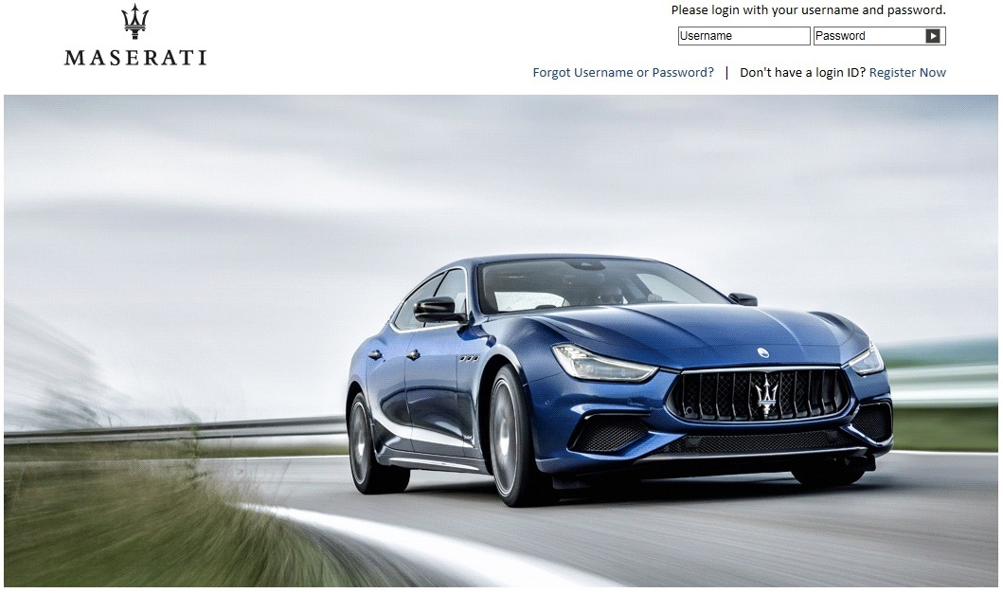
Introducing
Maserati USA Direct
Notes:
The layout presented in this file is only an option. If you recommend another layout, feel free to explore. The screenshots can be overlaid on a desktop computer image/monitor. However, if you recommend another option that would better compliment the screenshots and layout, feel free to explore.
Animate “Introducing” then “Maserati USA Direct”
Bring in a desktop with the screenshot overlay on the monitor
Visual indication: login action (i.e. Username field, Password field, click arrow)

Slide 4
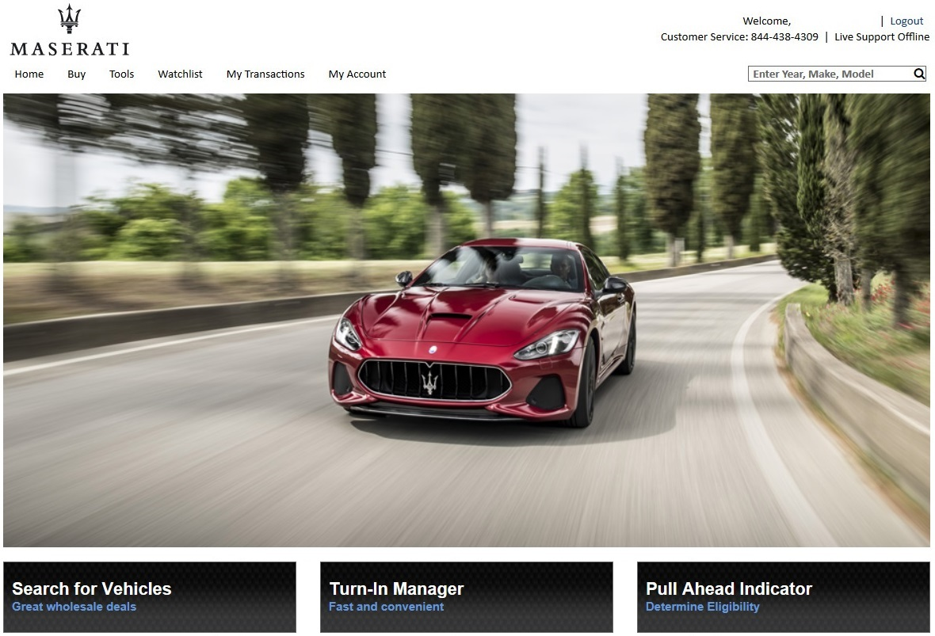
Turn-In Lease Returns
Notes:
- Show Home Page

Slide 5
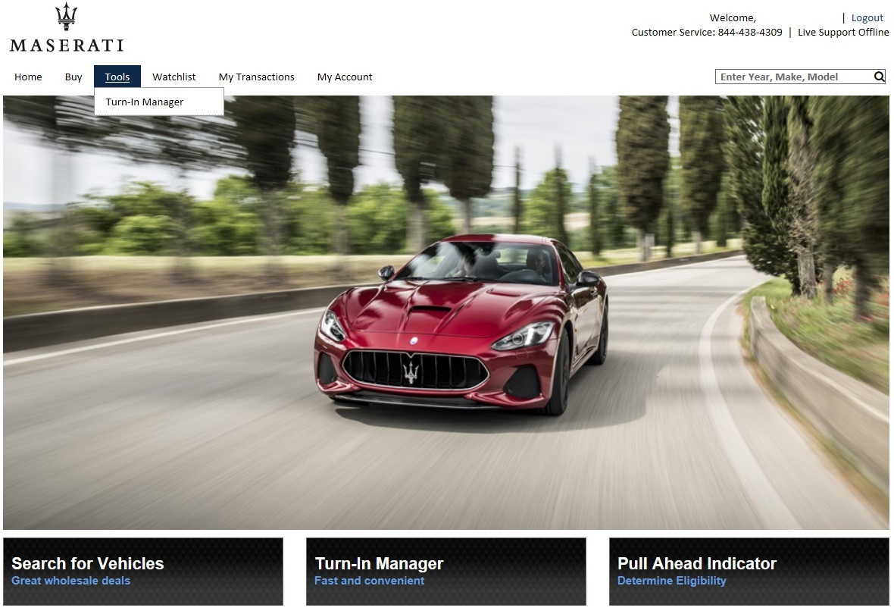
Turn-In Lease Returns
Easily ground and manage your off-lease vehicles
Notes:
- Visual indication: hover over Tools, then select Turn-In Manager from dropdown

